Slide 1



NeXT STEPS

Slide 2

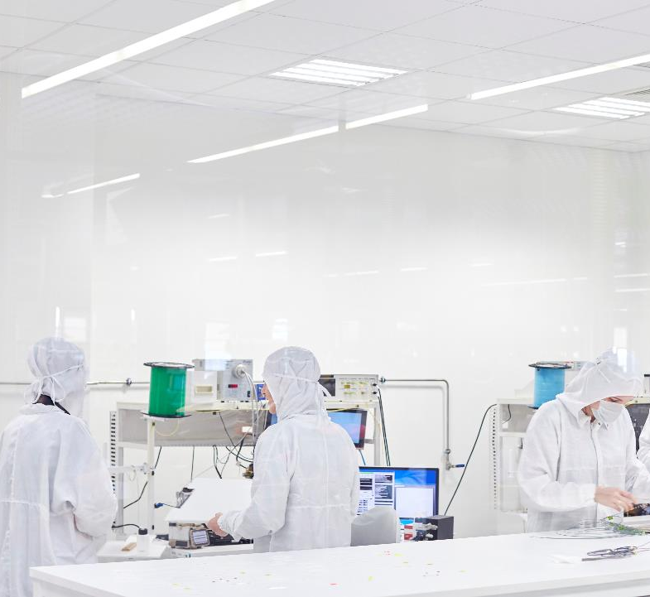
CRUD-Processing
TimeSeries
QuestDB
GridDB

Slide 3
Capturing and Processing Messages
Lot more complicated than we think
Need specialized Databases like timeseries :QuestDB,GridDB
QuestDB is used by Airtel in IndIA
GridDB has announced a Hackathon in DevPoST
Aroon Indicator for Trend reversal Identification
Under Time-series analytics and visualizations

Slide 4
ESP32 or Other Controllers
Display in Localization :Indian Languages support
Number plate Reading
https://pyimagesearch.com/2020/09/21/opencv-automatic-license-number-plate-recognition-anpr-with-python/

Slide 5
Robotics Simulations
Pybullet with Docker
Try to catch a moving Target
GazeBO

Slide 6
CoURSES
Create a working IoT Project - Apache Kafka, Python, GridDB(Udemy)
GAzeBO online Simulator

